Slide 1
PREDDICTING REDDIT
-ANIRUDH KASHYAP

Slide 2
OVERVIEW
BACKGROUND
REDDIT SCRAPING
SCRAPING STATISTICS
PREDICTOR MODELS
CONCLUSIONS

Slide 3
WHAT IS REDDIT?
Reddit is the “Front Page of the Internet”
Content aggregated site containing text posts & links submitted by registered users
Individual topic based subreddit system
250mn registered users, 853k subreddits, 8bn pageviews, 8th most popular website

Slide 4
HOW DOES REDDIT WORK?

Slide 5
The goal
What characteristics of a post contribute most to the overall interaction (as measured by comments)?

Slide 6
Scraping Reddit
250 pages/time. Scraping every 6 hours
125K posts scraped. 10000 unique posts.
Post Details: Time of post, upvotes, comments, username, flair, Type of Link. Title
8000 User Ids + User Karma + User Comment Karma
1500 Subreddits + Subreddit Subscriber information
User/Subreddit info collected once a week (static)

Slide 7
Subreddit/Subs | Users/PostKarma
😐

Slide 8
Reddit Comment Growth

Slide 9
Reddit Upvote Growth

Slide 10
Features Examined
Subreddit | Subreddit Subscribers
Username | User Post Karma | User Comment Karma
Title | Title Words | Length of Title
Time on Reddit | #Upvotes | #Comments
Type of Post (Image/Video/Article/Text)

Slide 11
Predicting Reddit Front Page - MLR
Prediction: MaxComments
Input: MaxUpvotes, UserComment Karma, MaxTime on Reddit
Model Score: 0.169

Slide 12
Predicting using a Classification Problem
Using #Comments on post as a classifier
Median of #Comments: 35.0
Posts with > 35 comments classified as 1, Posts with <35 comments as 0

Slide 13
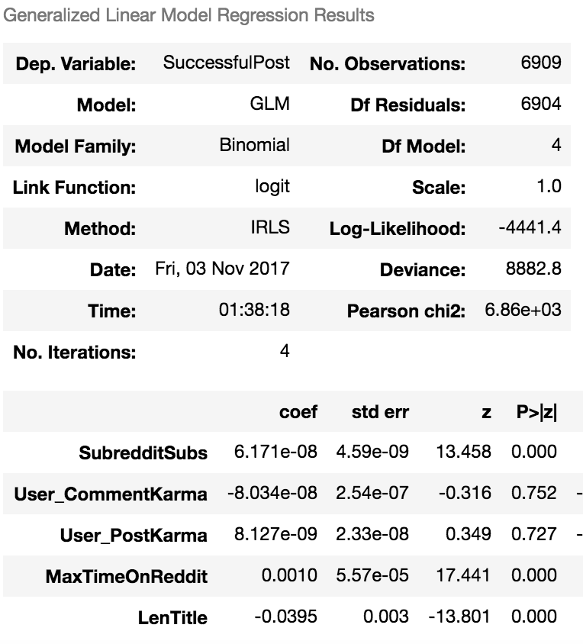
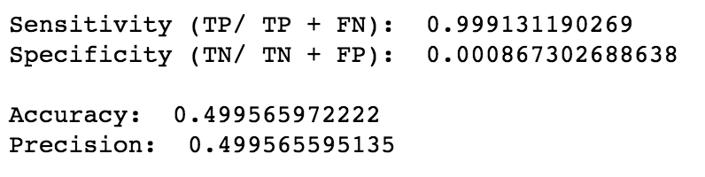
Logistic Regression - Baseline
Dependent Variable: Successful Post
Things can only look better after this!

Slide 14
K-Nearest Neighbors
Non-parametric lazy test that looks at the classification of its nearest neighbors
Increasing the K value, reduces variability and increases bias
Accuracy drops with higher K-values

Slide 15
K-Nearest Neighbours
K-NN does better job of predicting the chances of success for our reddit post
Peak accuracy is @ 0.72
Improvement over Logistic Regression

Slide 16
Random Forest
Random Forests are bagged Decision Trees. They are averaged Decision Trees
Convenient to use because of their simplicity. Lower bias, but better accuracy

Slide 17
Random Forest - Progression
Random Forest Predictors | Model Score
Subreddit | 0.684 ± 0.013
Subreddit, Post Type, User_Name | 0.654± 0.007
Subreddit, Post Type, User_Name + SubSubscribers, User_PostKarma, Len(Title) | 0.704 ± 0.007

Slide 18
Count Vectorization
Process Title & Understand Frequency of words
Word Processing involved:
Removing stop words
Fixing Punctuations
Using lowercase
Lemmatization
Removing “r”
Count Vectorizing Title of Post

Slide 19
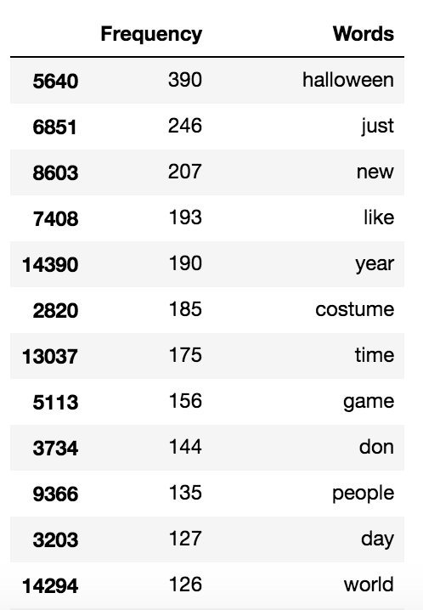
Word Frequency

Slide 20
Random Forest - Progression
Random Forest Predictors | Model Score
Subreddit | 0.684 ± 0.013
Subreddit, Post Type, User_Name | 0.654± 0.007
Subreddit, Post Type, User_Name + SubSubscribers, User_PostKarma, Len(Title) | 0.704 ± 0.007
Adding Count_Vectorized Top 500 Words | 0.753 ± 0.01

Slide 21
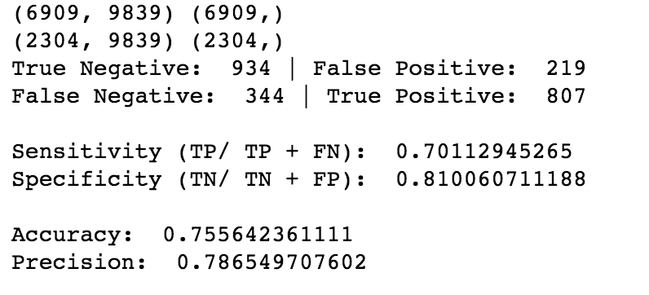
Using Confusion Matrix
☺

Slide 22
Conclusion
We have analyzed the factors that affect the likelihood of success of a reddit post
The models used: MLR, Logistic Regression, KNN, Random Forest
Training, Test data used for our models
Best predictions made using Random Forest with an Accuracy score of 0.755

